Slide 1
6. The Process of Leading (Leadership, Motivation and Communication)

Slide 2

Leadership

Slide 3
Meaning of Leadership
Leadership is the ability to build up confidence and zeal among people and to create an urge in them to be led. To be a successful leader, a manager must possess the qualities of foresight, drive, initiative, self-confidence and personal integrity. Different situations may demand different types of leadership.

Slide 4
Leadership- Definition
Leadership is defined as “ ……the ability to influence people toward the attainment of goals”
( Daft,2012)
“Leadership is the process of directing and influencing the task-related activities of group members”
(Stoner, Freeman & Gilbert, 2009)

Slide 5
Leadership, Power and Influence
Leadership: leadership is identified as the ability to use different forms of power to influence behaviour of followers.
The exercise of power is a social process, and it is the ability to affect behaviour of others. Power is the capacity to cause a change.
Power is derived from different sources of power :
Influence is the leader’s effect on the values, attitudes or behaviour of others.
Power
Legitimate Power
Reward Power
Coercive Power
Referent
Power
Expert Power

Slide 6
Leadership and Management
Leadership and Management are related but they are not the same.
Organizations need both Management and Leadership if they are to be effective.

Slide 7
Difference between Leader and Manager
Criteria | Manager | Leader
Members known as | subordinates | Followers
Position lies at | Formal Structure | Formal Structure /Informal Structure
Sources of power | Positional | Personal
Attitude towards Change | Status-quo | Innovative
Respect | Expect | Receive
Type of decision making | Rational, Logical, Analytical | Emotional, Charismatic
Primary Goal | Company Goal | Followers Goal

Slide 8
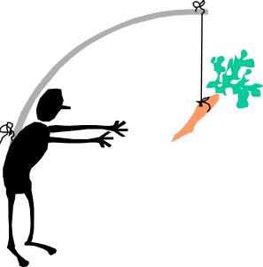
Motivation

Slide 9
Definitions of Motivation
Motivation is the set of forces that cause people to behave in certain ways.
(Griffin, 2010)
Motivation is a process that starts with a physiological and psychological deficiency or need that activates a behaviour or a drive that is aimed at a goal or incentive.
(Luthans, 2011)

Slide 10
Process of Motivation
Unsatisfied Needs
Tension
Drives
Reduction of Tension
Satisfied Need
Search Behaviour

Slide 11

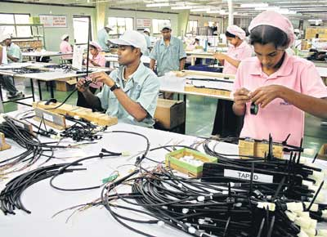
Importance of employee motivation in the workplace

Slide 12


Communication

Slide 13
Communication- Definitions
Communication is the process by which information is exchanged and understood by two or more people, usually with the intent to motivate or influence behavior.
(Daft,2012)
The process of transmitting information from one person to another.
(Griffin,2012)

Slide 14
Process of Communication
Idea
Message
Reception
Behaviour
Encoding
Media
Decoding
Understanding
Sender
Transmission
Receiver
Noise
Feedback

Slide 15
Communication Terms
Communication
The transfer and understanding of a message between two or more people.
Sender
Is anyone who wishes to convey an idea or concept to others, to seek information, or to express a thought or emotion.
Receiver
Is the person to whom the message is sent. Decodes the message and provides feedback to the sender.
Notes:
Material pertinent to this discussion is found on page 252.

Slide 16
Communication Terms (Cont…)
Encoding
Converting a message to symbolic form.
Decoding
Interpreting a sender’s message.
Message
What is communicated.
Channel
The medium through which a message travels.
Notes:
Material pertinent to this discussion is found on pages 252-253.

Slide 17


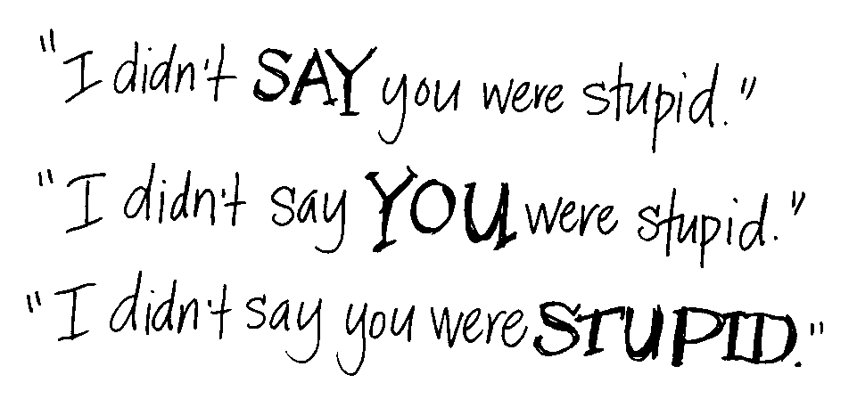
Methods/ Forms of Communication
Verbal Communication
Non Verbal Communication
Para Verbal Communication

Slide 18
Organizational Communication
Includes all the patterns, networks and systems of communication within an organization.
Important aspects of organizational communication are ;
Formal Vs Informal communication
Direction of communication flow
Communication networks

Slide 19
Formal Vs Informal Communication
Formal Communication refers to communication that take place within prescribed organizational work arrangements.
Informal communication is organizational communication not defined by the organization’s structural hierarchy.
(Robbins,2012)

Slide 20
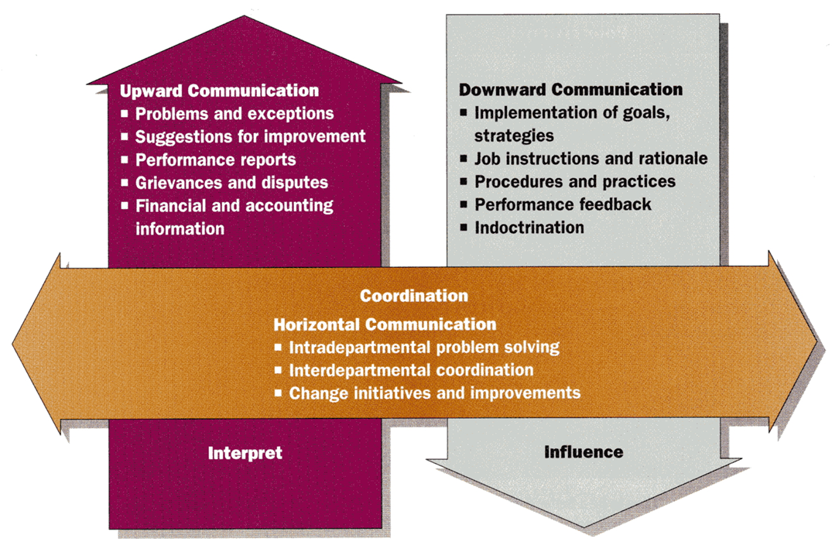
Direction of communication Flow
Downward Communication
Upward Communication
Horizontal (Lateral) Communication
(Daft,2012)

Slide 21
Organizational Communication Networks
The vertical and horizontal flows of communication can be combined into a variety of patterns called communication network.
Formal Networks
Informal Networks (Grapevine)

Slide 22
Effective Communication
The effectiveness of communication is measured by;
the degree of understanding and
the appropriateness of the response by the receiver as intended by the sender.

Slide 23
Barriers to Communication
Conflicting or inconsistent signals
Credibility about the subject
Reluctance to communicate
Poor listening skills
Semantics
Language differences
Status of power differences
Different perceptions
Noise
Overload

Slide 24
Overcoming Barriers to Communication
Develop good listening skills
Encourage two way communication
Follow up
Be aware of language and meaning
Understand the richness of the channel used
Maintain credibility
Be sensitive to receiver’s and sender’s perspective

